Slide 1
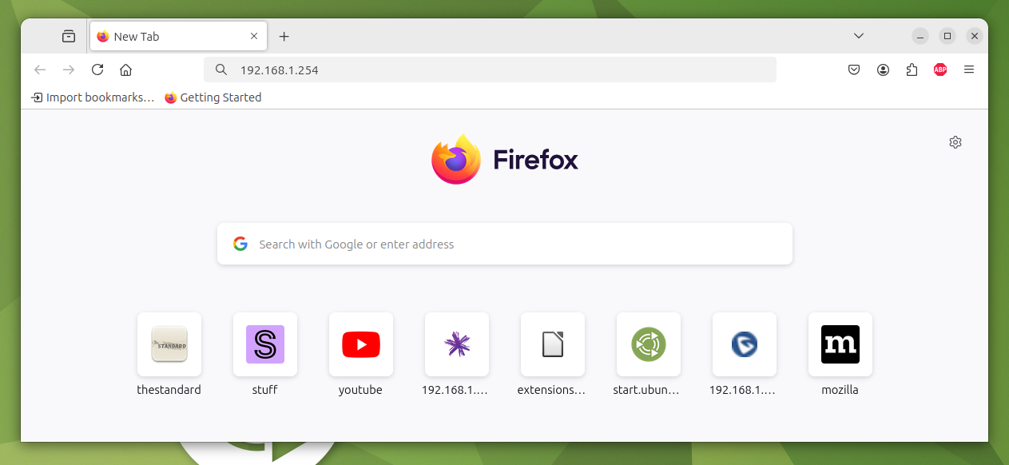
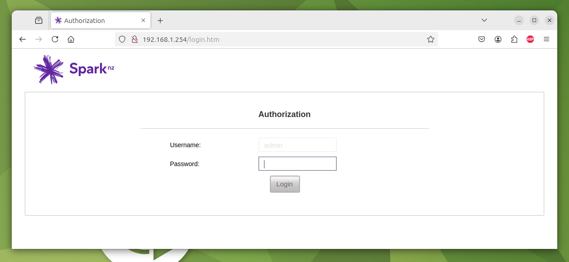
Changing the TP_Guest Wifi Password on a Spark SM3 Modem
Attn: Te Papanui Enderley Community Trust Staff.
Author: Ian Stewart
Date: 2025-02-03
Introduction
In the downstairs data cabinet, on the top shelf, there is a modem. This allows all users in Te Papanui to connect to the Internet. This modem stores the SSID password for TP_Guest. As this password is frequently handed out to guests there is a need to change it from time to time. The following describes how to change the TP_Guest password.
Steps:
1. On a PC that is connected to the internal network, launch the Firefox web-browser.
2. In a new browser tab enter into the address field the address of the administration port for the modem: 192.168.1.254
Type Address 192.168.1.254 then press Enter
3. The web-server within the modem will then send to your PC the administration login page. As shown below…
Page <number>

Slide 2
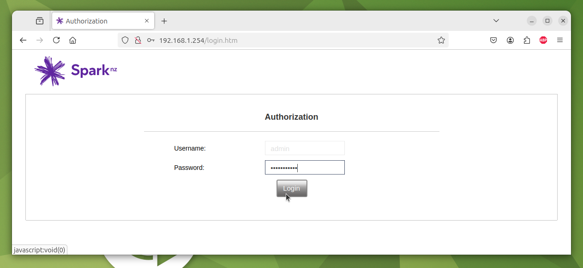
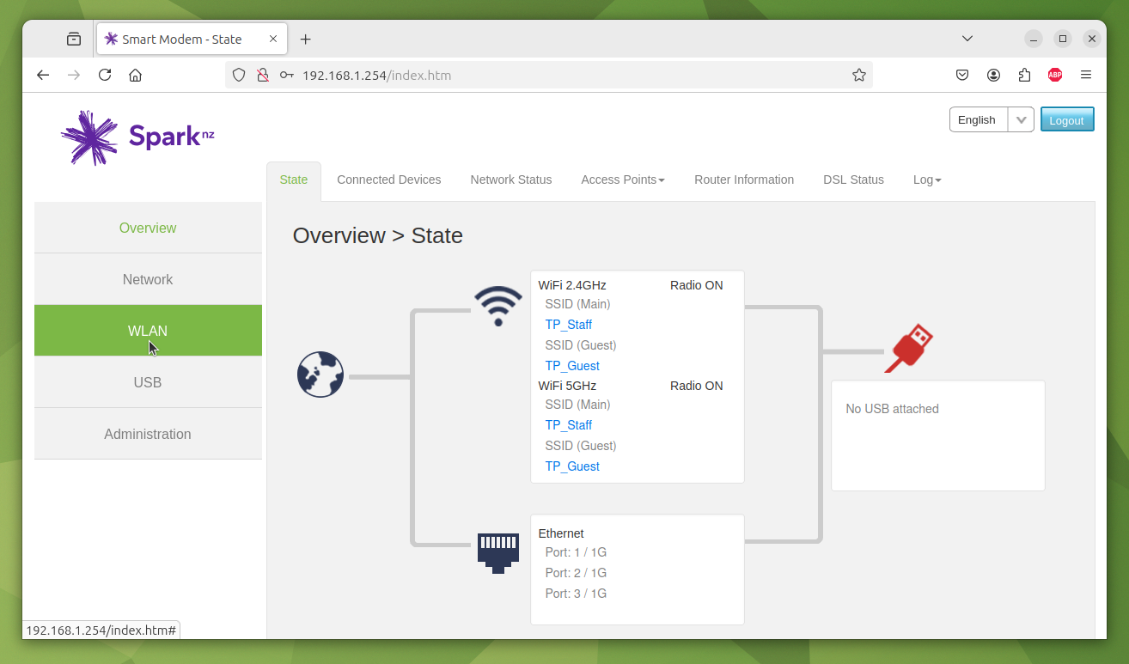
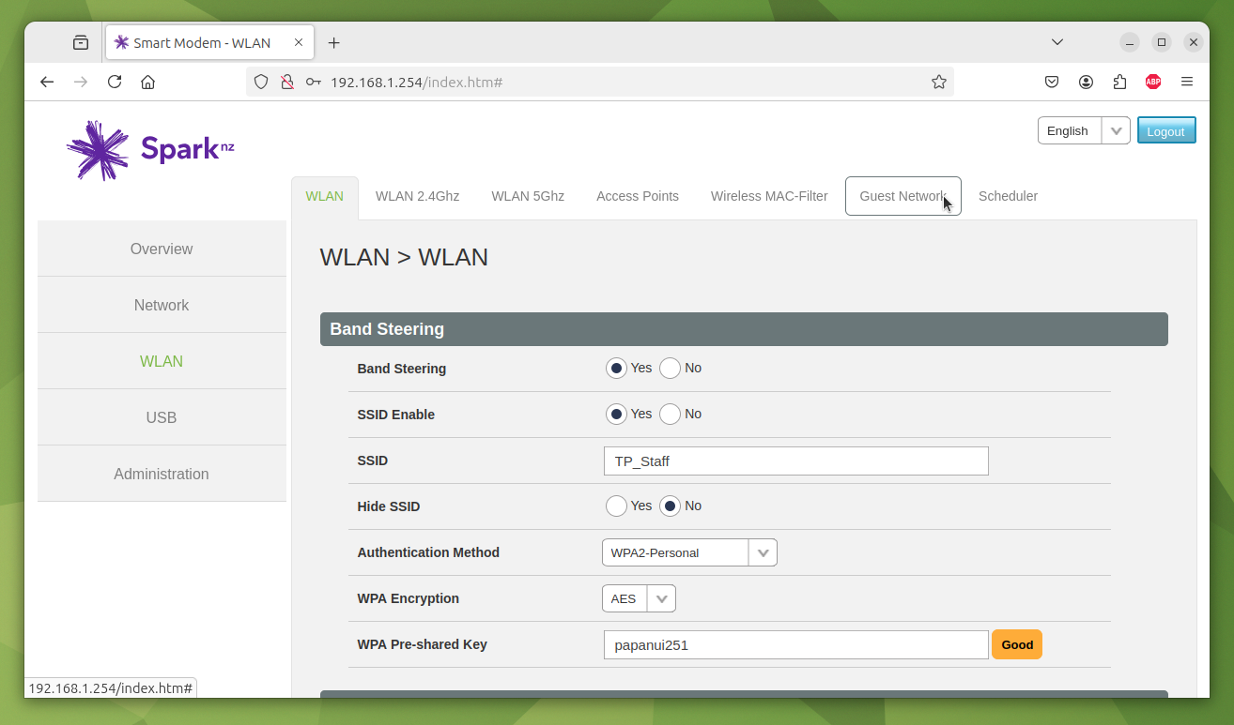
4. The Username is already set to: admin. Enter the modem Password and click on Login...
Username defaults to “admin”
Enter modem password
Click
5. On logging in to the Home page for the modem, Click on: WLAN...
Click
6. On the WLAN screen Click on Guest Network...
Click
Page <number>

Slide 3
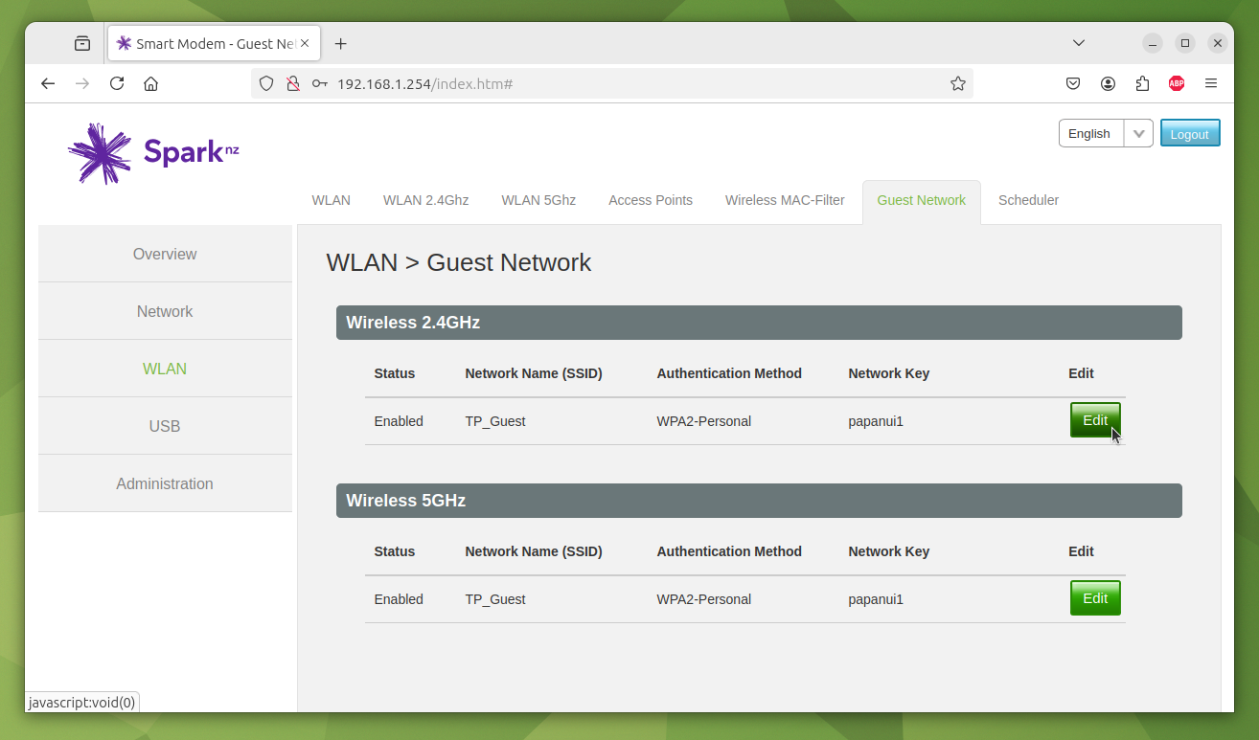
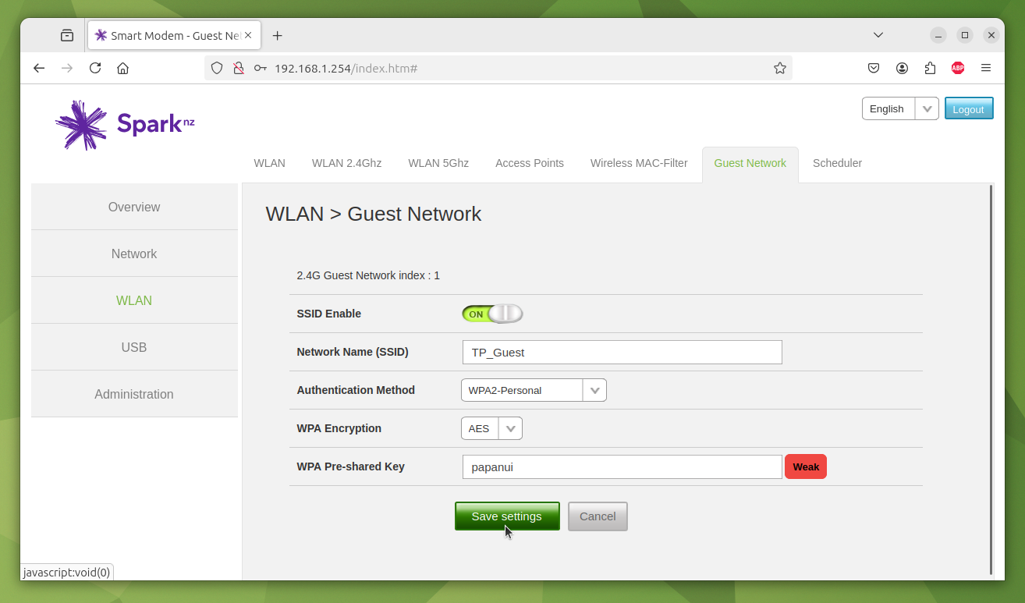
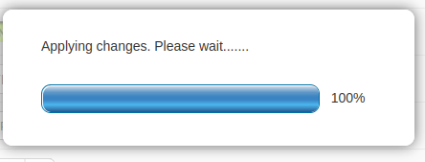
7. Click on the Wireless 2.4GHz Edit button...
Click
8. Change the password in the WPA Pre-shared Key field. The password must contain 8 or more characters. Then Click on Save Settings...
Change to new password
Click
9. Saving the new password may take about 15 seconds. During this time the screen displays...
Page <number>

Slide 4
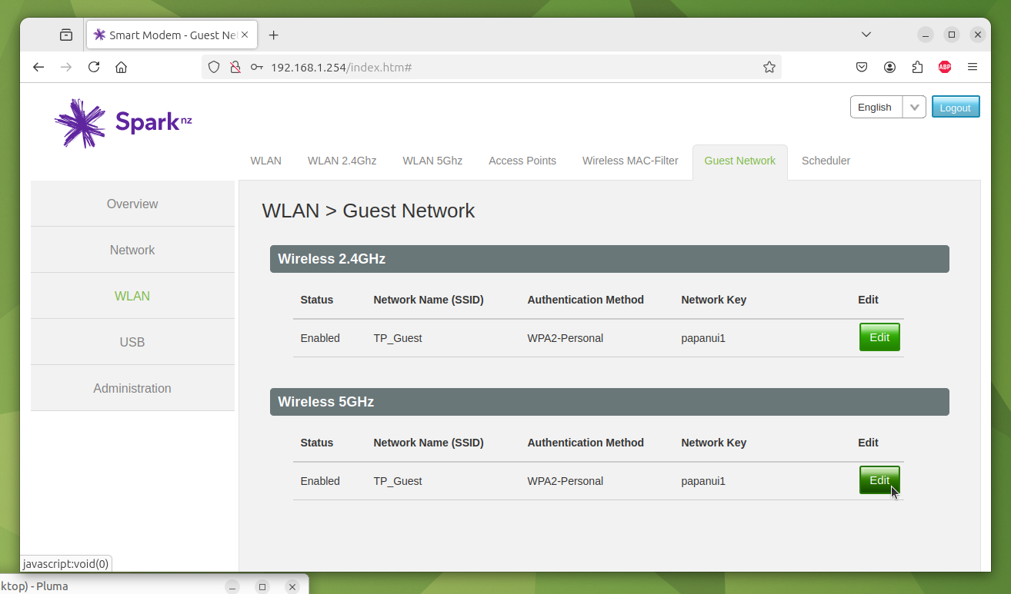
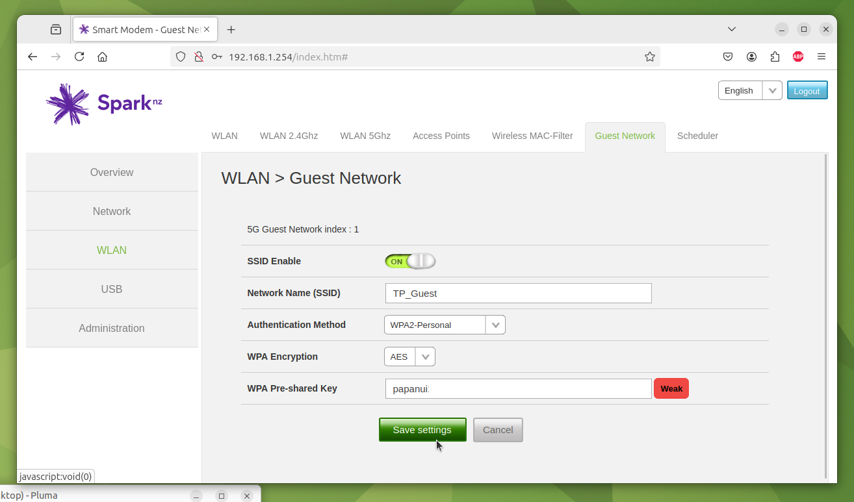
10. The Guest Network screen is displayed again, this this time Click on the Wireless 5GHz Edit button...
Click
11. Change the password in the WPA Pre-shared Key field. Use the same password as 2.4 GHz Wireless. Then Click on Save Settings...
Change to new password
Click
12. Saving the new password may take about 15 seconds. During this time the screen displays...
13. Finished. Click on the Logout button.
Page <number>

